Slide 1
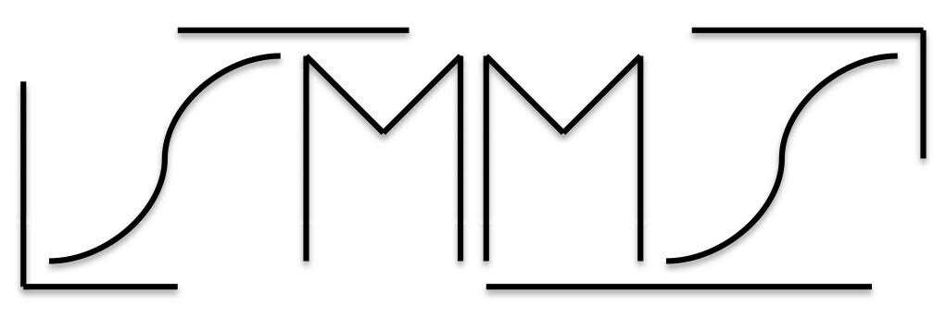
Social Media Made Simple
“Taking your business into the age of digital marketing”

Slide 2







Vision Statement
Our vision is to exemplify excellence in the area of social media marketing. We have highly skilled marketing managers and sales reps, paired with years of knowledge in Digital Marketing and branding over the major social media platforms, making us the go-to Digital Marketing firm in the United States, servicing small, medium, and large businesses

Slide 3

Mission Statement
It is our mission at SMMS to be Beasts in our industry. We will become the most reliable, proficient, and dependable social media marketing company, providing the lift companies need, to maximize their reach.

Slide 4
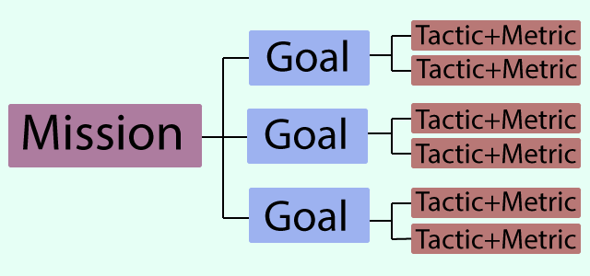
Objectives
Spearhead the south with efficient and affordable social media marketing packages tailored to fit any size business
Provide companies with a level of reach and exposure in the growing social media market, reaching the current and upcoming generations of online users
Revolutionize social media marketing strategies for all varieties of businesses

Slide 5
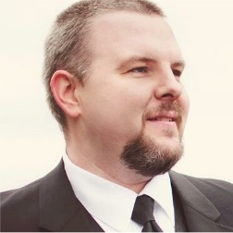
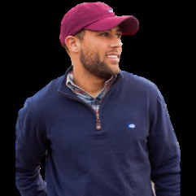

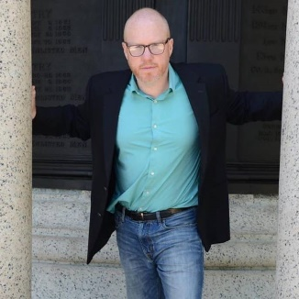
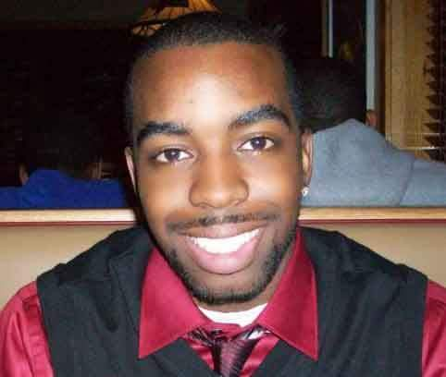
Organizational Chart
Jared Ward CEO
Antonio Williams VP of Operations
Devon Morgan CTO
Cory Barnes Sr. Sales Manager

Slide 6

Licenses / Permits
Compliance with all documentation necessary to be an established LLC
Obtain relevant social media certifications & training

Slide 7

Pricing Models
Small Business (500 or fewer employees & Less than $7 million in annual sales) $3500/month + $1000 in ad-spend 20 social media posts across 3 platforms per month Email Marketing – 1 Newsletters per month Monthly Meeting: Review of Analytics
Large Business (500 or more employees & more than $7 million in annual sales) $5500/month + $2000 in ad-spend 32 social media posts across 3 platforms per month Email Marketing – 2 Newsletters per month Monthly Meeting: Review of Analytics ClickFunnel Tools

Slide 8

Budget: 6 Months
20 Clients 10 Small Businesses / 10 Large Businesses Revenue: $720,000 over 6 months Salaries
CEO: $250,000 /yr.
CTO: $200,000 /yr.
VP of Ops: $150,000 /yr.
Sr. Sales Manager: $100,000 /yr. Tools
Constant Contact: $70 /month
Buffer: $199 /month
Certifications: $3000 flat rate Operational Funds Needed
$354,614 budget needed to run the business for 6 months

Slide 9

Target Markets
Small and Large Businesses
Restaurants
Doctor’s Offices
Dentist Offices
Donut Shops
Entertainment Stores (Comics, Gaming, Conventions)

Slide 10

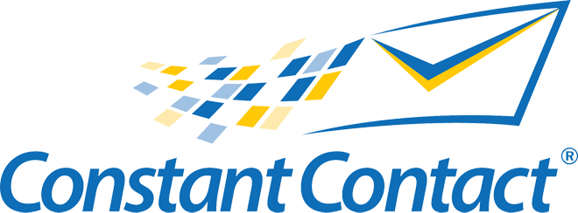



Software Tools & Certifications
Constant Contact – Email Marketing Tool
Hootsuite / Buffer – Social Media Account Management & Scheduling
Training & Certifications – Facebook BluePrint

